Slide 1
Digital Control Systems
Chapter 7

Slide 2
Review of Last Chapter
Controllability and observability
What is state feedback control
How to design a state feedback controller
State feedback with integral control
How to design a state observer
How to design a state feedback controller with feedback states coming from an observer

Slide 3
Outlines
Basics about digital control systems (discrete-data control systems )
Interfaces between continuous and discrete-data systems ----- the Sample-and-hold device
Tools for analyzing and synthesizing discrete-data systems ----- the z-transform and inverse z-transform
Discrete-data models of control systems
Pulse-transfer functions
Discrete state equation
Discretization of continuous system
  from transfer function to z-transfer function
  from state equation to discrete state equation

Slide 4
Basics about Digital Control Systems
A system with digital controller is called as a digital control system.
The most distinct characteristic of a digital control system is that there exist
discrete blocks in the control system.
Inputs are analog signals
r
(
t
)
+
e
(
t
)
e
*
(
t
)
Digital
Computer
u*
(
t
)
u
(
t
)
y
(
t
)
A/D
D/A
Process
－
b
(
t
)
Sensors
Inputs are digital signals
r*
(
t
)
+
e
*
(
t
)
u*
(
t
)
u
(
t
)
y
(
t
)
Digital
Computer
D/A
Process
－
b*
(
t
)
b
(
t
)
A/D
Sensors

Slide 5
A/D Converter
x
(
t
)
x*
(
t
)
x
(
T
)
Sampling
Period
x
(
2
T
)
x
(
0
)
x
(
3
T
)
x
(
4
T
)
T
t
0
T
2
T
3
T
4
T
t
Continuous
Signal
x
(
t
)
Ideal
Sampling
Switch
Discrete
Signal
x*
(
t
)
The function of an A/D converter can be represented by an ideal sampling switch.
The output of the ideal sampler is a train of impulses with the magnitude of
x(t) at each sampling time carried by the strength of the impulse.
Mathematically, the sampled discrete signal sequence can be expressed by the convolution of the continuous signal and an impulse train with each impulse separated by sampling period T.

Slide 6
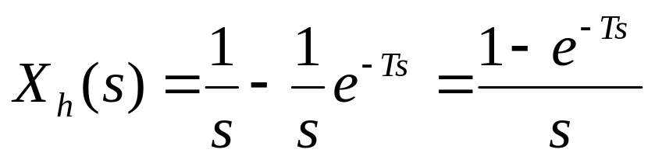
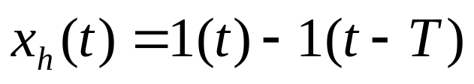
D/A Converter
x
(
t
)
h
δ
(0)
1
0
T
t
0
T
t
ZOH
x*
(
t
)
x
(
t
)
h
The D/A converter is usually a zero-order hold (ZOH). The ZOH simply holds the
magnitudes of the signal carried by the incoming impulse at a given time instant for the entire sampling period until the next impulse arrives. The output of the ZOH is a staircase approximation of the input impulse sequence.

Slide 7
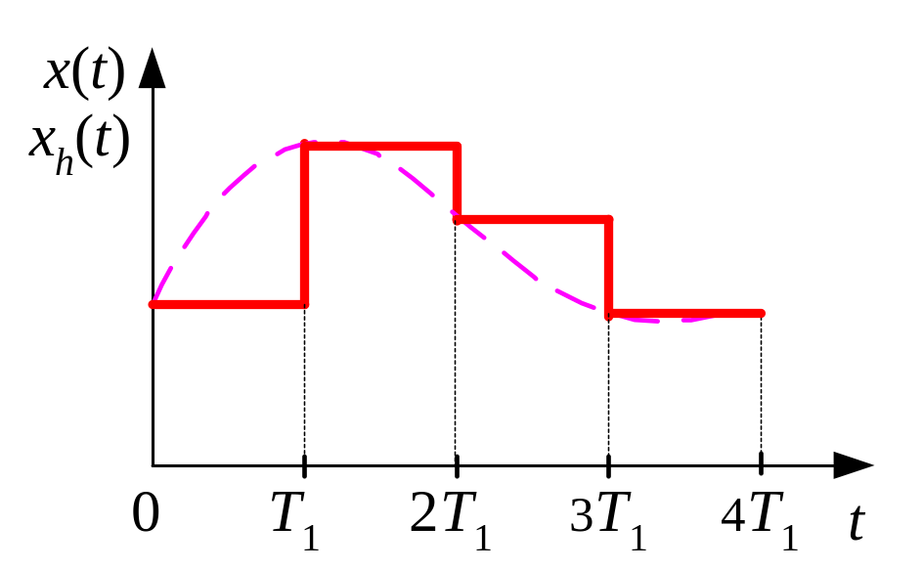
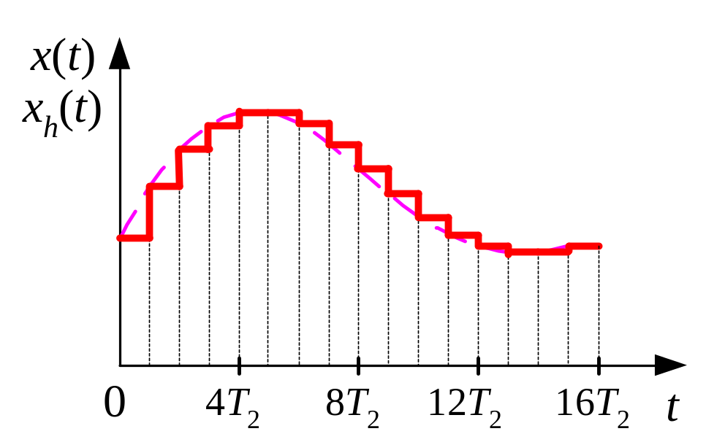
Sample-and-hold Device
x
(
t
)
T
x*
(
t
)
(
1
−
e
−
sT
)
x
(
t
)
h
s
sampler
ZOH
The output of the ZOH is a staircase approximation of the input to the ideal
sampler. As the sampling period approaches zero, the output of the ZOH
approaches the input.

Slide 8
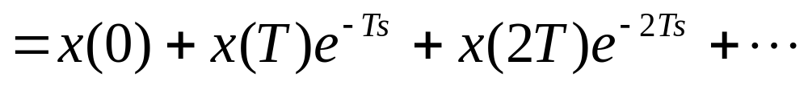
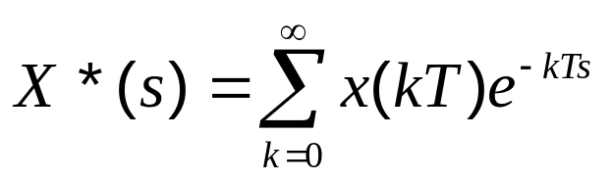
Block Diagrams of Digital Control Systems
R
(
s
)
+
E
(
s
)
T
E*
(
s
)
U*
(
s
)
U
(
s
)
Y
(
s
)
G
*
(
s
)
(
1
−
e
−
sT
)
G
(
s
)
Sampler
c
s
p
-
Discrete-Data
Controller
ZOH
Controlled
Process
Discrete-data sequence and its Laplace transformation:

Slide 9


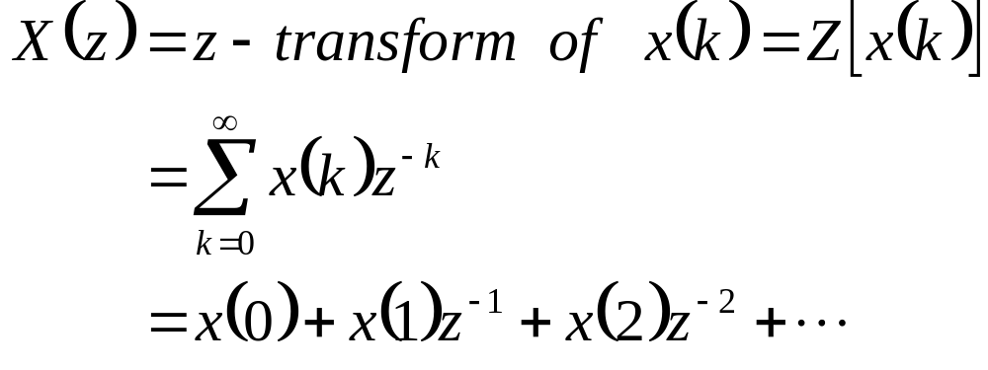
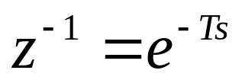
Z - Transform
Consider the sequence , the Z-transform of is defined
as:
where z is a complex variable with real and imaginary parts.
Comparing with the Laplace transform of a discrete-data sequence
Z-transform may be regarded as a special case of the Laplace transform of
a discrete-date sequence with sampling time T equal to 1.

Slide 10
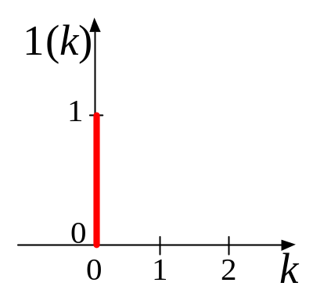
Z - Transform
1(
k
)
1
0
0
1
2
n
k

Slide 11

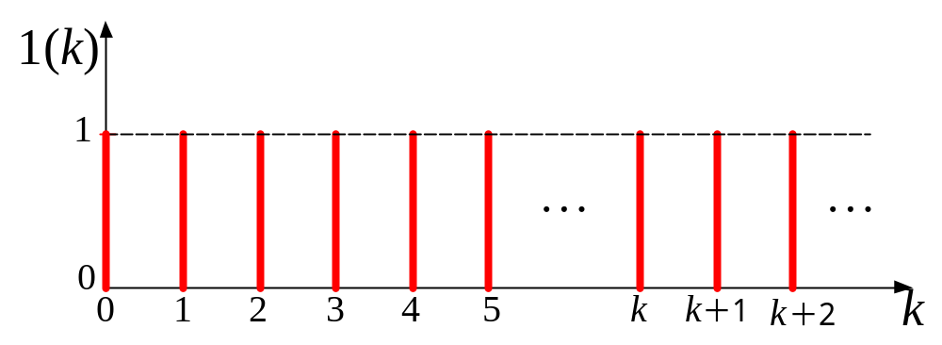

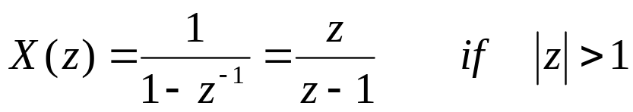
Example – 7.1
Q: please find the z-transform of the unit-step function
A: the unit-step function is a continuous function. It needs to be discretized
before applying z-transform.
Assume the sampling period is T, after discretized, the sequence becomes:
geometric progression
Notes:
geometric progression

Slide 12

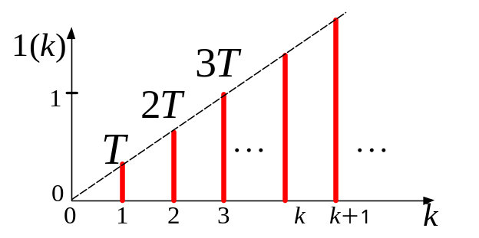

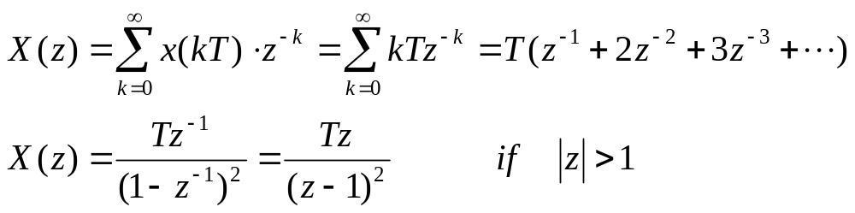
Example – 7.2
Q: please find the z-transform of the unit-ramp function
A: the unit-ramp function is a continuous function. It needs to be discretized
before applying z-transform.
Assume the sampling period is T, after discretized, the sequence becomes:
Notes:
geometric progression

Slide 13

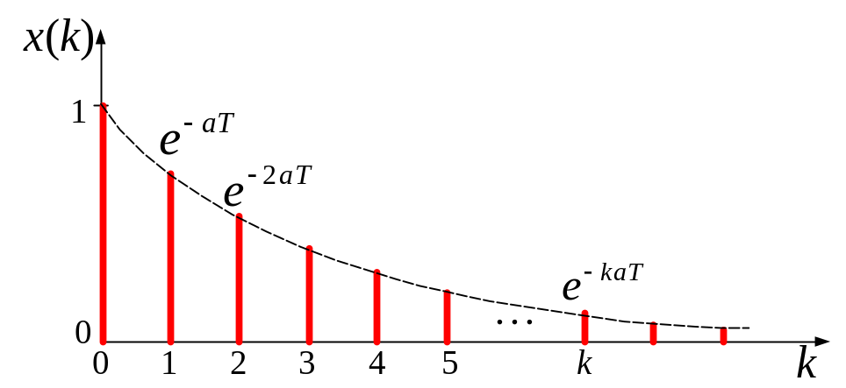
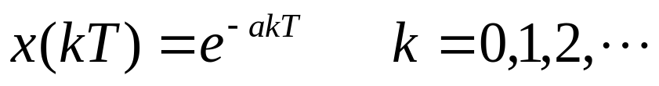
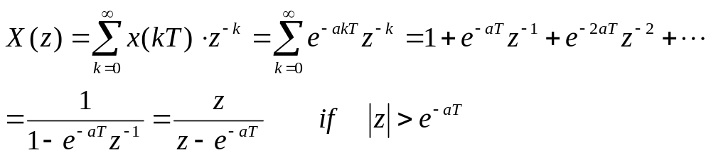
Example – 7.3
Q: please find the z-transform of the exponential function
A: the exponential function is a continuous function. It needs to be discretized
before applying z-transform.
Assume the sampling period is T, after discretized, the sequence becomes:
Notes:
geometric progression

Slide 14
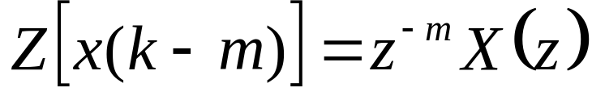
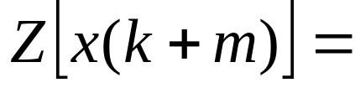
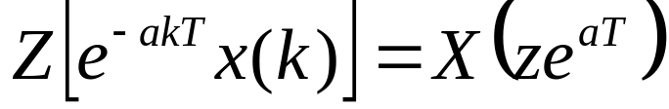
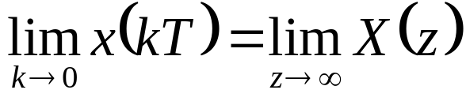
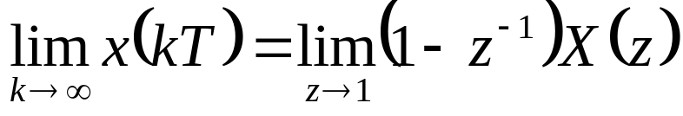
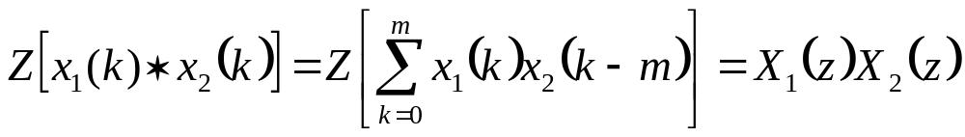
Some Important Theorems of the z-Transform
Real Translation (Time delay)
Real Translation (Time advance)
Complex translation
Initial-value theorem
Final-value theorem
Real Convolution
Notes:
geometric progression

Slide 15
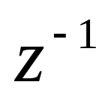
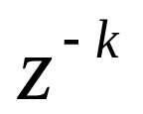
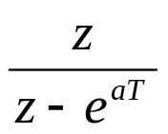
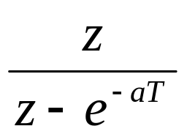
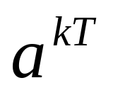
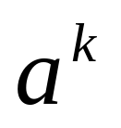
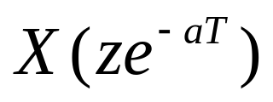
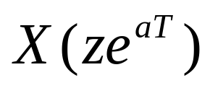
Wrong
Correct
Table 7.1
Row 3
Column 4
Table 7.1
Row 6
Column 4
Table 7.1
Last Row
Column 3
Table 7.2
Row 7
Column 3
Notes:
Corrigenda

Slide 16
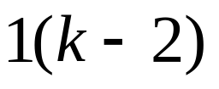
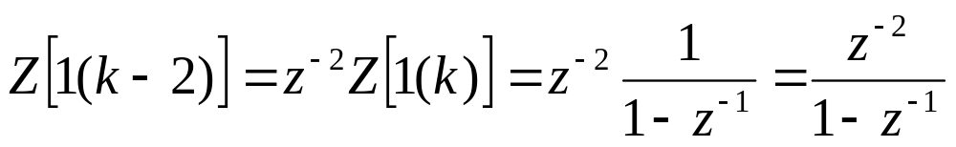
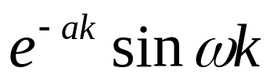
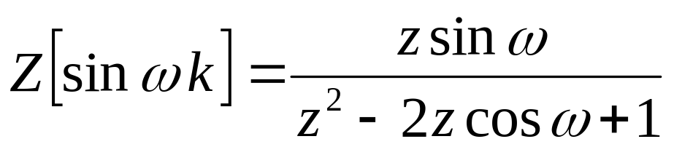


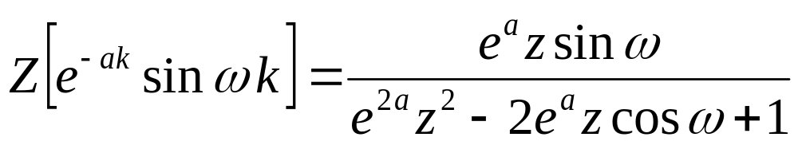
Some More Examples
Q: please find the z-transform of the following functions
using to replace
Notes:
geometric progression

Slide 17



Inverse z-Transform
Just as in the Laplace transform, one of the major objectives of the z-transform is
that algebraic manipulation can be made first in the z-domain, and then the final
time response is determined by the inverse z-transform.
In general, the inverse z-transform of a function yields information on
only, not on . In other words, the z-transform carries information only at
the sampling instants.
The inverse z-transform can be carried out by one of the following three methods:
Power-series method
Partial-fraction expansion
Residue method

Slide 18
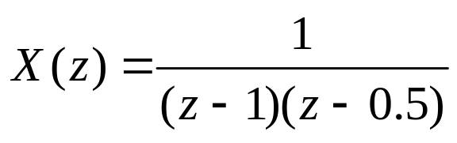
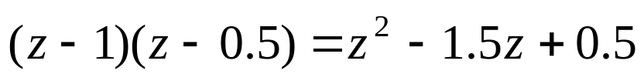
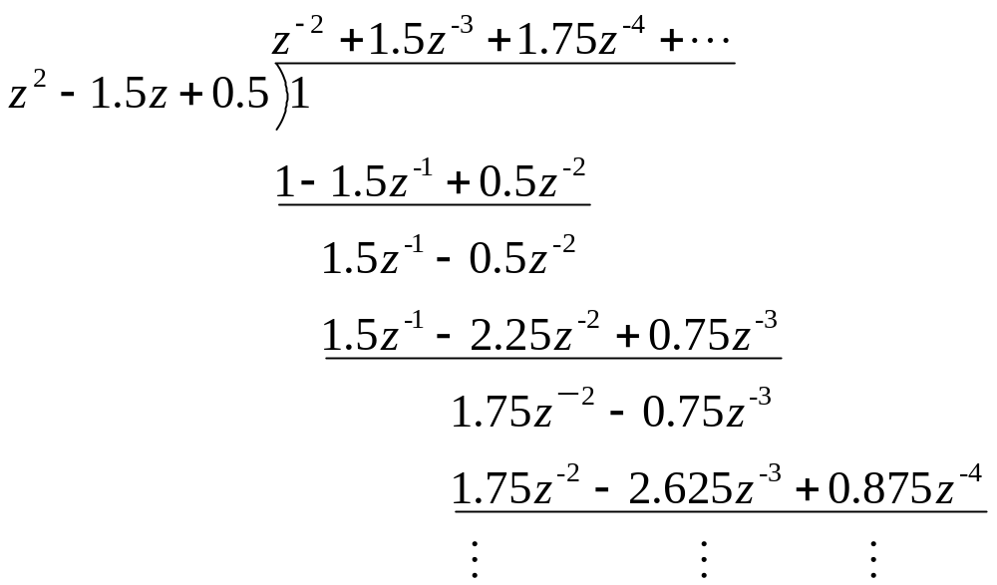
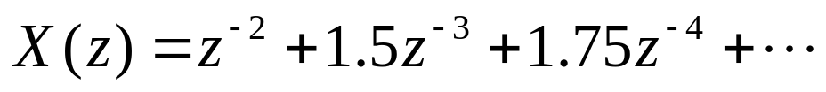
Example – 7.7
dividend
Q: please find the inverse z-transform of
A: use power-series method
divisor
quotient
Notes:
can not give the analytic expression

Slide 19
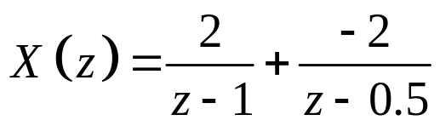
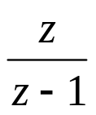
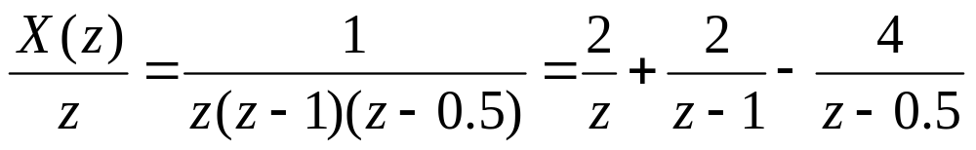
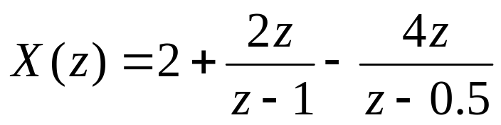
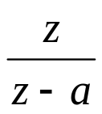
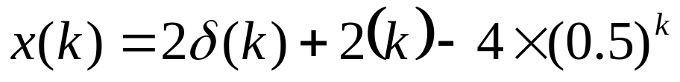
Example – 7.7
Q: please find the inverse z-transform of
A: use partial-fraction expansion
not in the look-up table

Slide 20
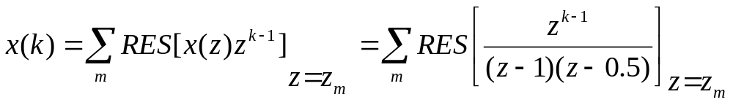

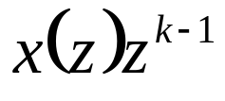

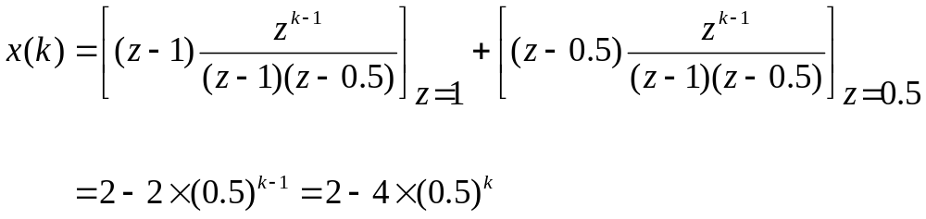
Example – 7.7
Q: please find the inverse z-transform of
A: use residue method
where is the poles of the expression
when , has two poles:

Slide 21

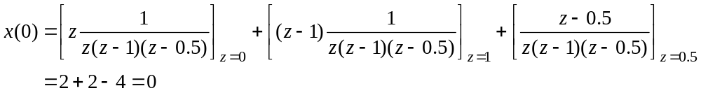
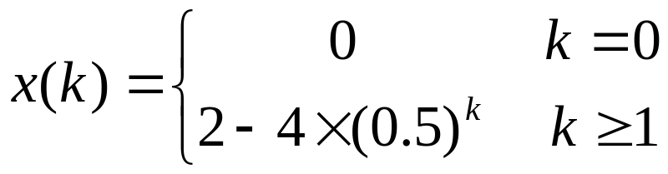
Example – 7.7
when , has three poles:
Notes:
Piecewise function

Slide 22




Example – 7.8
Q: please find the inverse z-transform of
A: use partial-fraction expansion

Slide 23


Example – 7.8
Q: please find the inverse z-transform of
A: use residue method

Slide 24

Remarks
z-transform and inverse z-transform are transformations between discrete-data
sequences and z-expression. The z-expression has nothing to do with the
continuous signals
Sampling
z-transform
x
(
t
)
x*
x
(
T
)
(
t
)
x
(
2
T
)
x
(
0
)
x
(
3
T
)
x
(
4
T
)
t
Hold
T
T
T
T
Inverse
z-transform
0
2
3
4
t

Slide 25
Discrete-Data Models of Control Systems
Why discrete-data models?
To implement a controller using digital computer
r
(
t
)
+
e
(
t
)
u
(
t
)
y
(t
)
G
(
s
)
G
(
s
)
c
p
-
Controlled
Process
Controller
r
(
t
)
+
e
(
t
)
T
e
(
kT
)
u
(
kT
)
u
(
t
)
y
(
t
)
G
(
z
)
(
1
−
e
−
sT
)
G
(
s
)
Sampler
c
s
p
-
Digital Controller
ZOH
Controlled
Process

Slide 26
Discrete-Data Models of Control Systems
To design a digital controller using discrete-data methods
r
(
t
)
+
e
(
t
)
u
(
t
)
y
(t
)
G
(
s
)
G
(
s
)
c
p
-
Controlled
Process
Controller
r
(
kT
)
+
e
(
kT
)
u
(
kT
)
y
(
kT
)
G
(
z
)
G
(
z
)
c
p
-
Controlled
Process
Controller

Slide 27




How to Get Discrete-Data Models of Control Systems
Forward Difference Method
Backward Difference Method

Slide 28



How to Get Discrete-Data Models of Control Systems
For a single-input-single-output linear time-invariant system, its discrete-data
model can be expressed as:
Backward difference form:
Foreword difference form:

Slide 29






Example – 7.9
Q: Use z-transform and inverse z-transform to solve the given difference equation
A:

Slide 30




Example – 7.9

Slide 31

Pulse-Transfer Function
Difference equation of a SISO LTI discrete system:
Apply z-transform to both sides:
Define the z-transfer function of the discrete system:

Slide 32




Pulse-Transfer Function
By definition:
If
then
It yields:
So, the z-transfer function of the discrete system is also called as the pulse
transfer function.

Slide 33


Discrete State Equations
Example 7.10: please find the discrete state equation of the system with the
given difference equation.

Slide 34






Discrete State Equations
Example 7.10: please find the discrete state equation of the system with the
given difference equation.
A:
choose

Slide 35






Discrete State Equations

Slide 36





Discrete State Equations
Example 7.11: please find the discrete state equation of the system with the
given difference equation.
A:
Applying z-transform to the above difference equation

Slide 37







Discrete State Equations

Slide 38




Slide 39




Slide 40




Discrete State Equations
Example 7.12: please find the discrete state equation of the system with the
given z-transfer function
A:
The denominator and numerator have the same order. It is not a proper
fraction. Need to convert it into mixed fraction first.

Slide 41





Get z-Transfer Function From Discrete State Equation

Slide 42


Example – 7.12
Q: please find the z-transfer function of the system with the given discrete
state equation.
A:

Slide 43
Discretization of a continuous model

Slide 44







From transfer function to z-transfer function
Method 1: look up tables
Method 2:
step 1:
step 2: sample and obtain the corresponding pulse
sequence
step 3: apply z-transform to and obtained z-transfer
function

Slide 45


Example – 7.13
Q: please find the corresponding z-transfer function of the given transfer
function.
A:

Slide 46




Example for method 2
Discretization:

Slide 47



Example for method 2

Slide 48





Differences between
and
Please find the z-transfer function of the open loop transfer function

Slide 49




Differences between
and
Obviously,
Please find the z-transfer function of the open loop transfer function

Slide 50






Differences between
and

Slide 51
Remarks
When deducing the corresponding z-transfer function according to a given
transfer function, it is important to pay attention to the location of ideal samplers.

Slide 52





Discretization:

Slide 53



Discretization:

Slide 54






From transfer function to z-transfer function
Method 1: look up tables
Method 2:
step 1:
step 2: sample and obtain the corresponding pulse
sequence
step 3: apply z-transform to and obtained z-transfer
function

Slide 55




Example – 7.14
Q: please find the corresponding z-transfer function of the system with the
following block diagram.
A:
G₀(s) = G₁(s)G₂(s)

Slide 56








u
(
t
)
T
u
(
k
)
y
(
t
)
y
(
k
)
Considering
We can consider as a discrete signal. Therefore, we can assume
there is a ideal sampler before
Now, we can use

Slide 57




Slide 58


Example – 7.15
Q: please find the corresponding z-transfer function of the system with the
following block diagram, then deduce the unit-step response of the system.
A:
according to the block diagram,

Slide 59





Slide 60
z=tf(‘z’);
g = (0.2*z+0.15)/(10*z^2-14.98*z+5.015);
step(g)
Step Response
0.35
0.3
0.25
System: g
Time (sec): 4.59
0.2
Amplitude: 0.186
Amplitude
System: g
0.15
Time (sec): 3.88
Amplitude: 0.122
System: g
0.1
Time (sec): 2.58
Amplitude: 0.065
System: g
0.05
Time (sec): 1.23
Amplitude: 0.02
0
0
0.5
1
1.5
2
2.5
3
3.5
4
4.5
5
Time (sec)

Slide 61









From State Equation to Discrete State Equation
Solve the above equation:
Set
and assume when
Select a new variable of integration:

Slide 62





From State Equation to Discrete State Equation
Set

Slide 63









Example – 7.16
Q: please find the discrete state equation of the given state equation
A:

Slide 64






Another way to calculate

Slide 65
From State Equation to Discrete State Equation
Question:
Can we just use difference to approximate derivative, then get the discrete
state equation?

Slide 66

单选题
1分
Can we just use difference to approximate derivative, then get the discrete state equation?
A
Yes
B
No
提交

Slide 67

From State Equation to Discrete State Equation

Slide 68


Set

Slide 69
Wrap-Up
Basics about discrete-data control systems (digital control systems)
Interfaces between continuous and discrete-data systems ----- the Sample-and-hold device
Tools for analyzing and synthesizing discrete-data systems ----- the z-transform and inverse z-transform
Discrete-data models of control systems
Pulse-transfer functions
Discrete state equation
Discretization of continuous system
  from transfer function to z-transfer function
  from state equation to discrete state equation

Slide 70
Assignment
Page 179
1，(1) (4)
2，(3) (4)
Page 179 ~ 180
3，(1) (2)
4

